Slide 1
Session 1-2: Building Confidence in the Administrative – Based Data – A Case of United Republic of Tanzania
A Paper Presented to the International Conference on the Sustainable Development Goals Statistics (ICSDGS) 4-6 October 2017 Manila, Philippines
By Dr. Albina Andrew Chuwa
Director General – Tanzania National Bureau of Statistics

Slide 2
Contents
Background Information
Opportunities around administrative based data – bridge existing data gap – responding to SDG’s Indicator Framework;
Challenges around administrative based Data in the developing Countries;
E-Population Register in Tanzania
The Forward Looking

Slide 3

Background Information
Administrative based data is the information collected primarily for administrative purposes. Government collects this type of data for the purposes of registration, transaction and record keeping, usually during the delivery of a service
to citizens.
% of Population with access to safety and Clean Water

Slide 4

Fundamental Principles of Official Statistics
Principle No. 5: Sources of Official Statistics FPO’s - build confidence of administrative –based data to be used to monitor performance auditing on going national, regional and global development plans.
Big data, Open data ???

Slide 5
Challenges – Building Confidence in the Administrative – Based Data Administrative –based data
Legal aspect: Data are coming from the existing systems which lead to difficulties to retrieve data required to monitor the progress made;
conformity of concepts and definitions with international standards, some of the NSO’s lags behind to cope with new paradigm shifts such as big data and open data, technologies and analysis.

Slide 6

Challenges – Building Confidence in the Administrative – Based Data
Incompleteness and inaccuracy of records is a serious constraints pertaining production of administrative data.
Use of Paper to register information from the Ministries still common in most of developing countries

Slide 7


–
Challenges
Capacity of the staff to fill-out the forms, do some quality checks, and analyze the data still ; and
Lack of political will to use data for evidence policy formulation and planning in some of the developing countries
e-Official Statisticians should revert the wheel – to gain political will

Slide 8
E-Population Register In Tanzania – Improvement of Administrative Based Data at LGA
Graduating from paper based data into electronic data system – Use of mobile technology both on and offline during data capture at household level;
Routine data collection tool in Tanzania

Slide 9
e-PRS as a working tool
Tanzania Administrative Hierarchy:
National level
Regional level
Distric level
Ward level
Village level
Sub-village level

Slide 10
e -PRS
Civil Register
Vital Register
Voters Register
Education
Revenue
Social Services
Health
Agriculture
Security
Governance

Slide 11
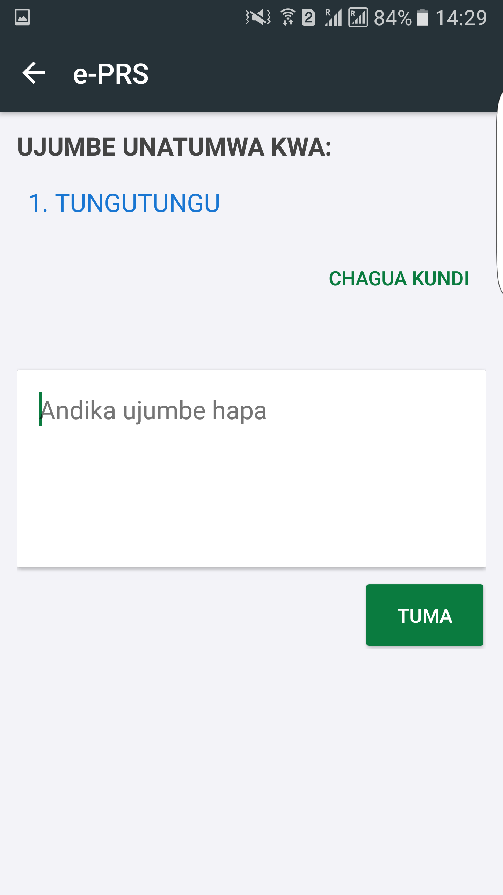
Send SMS to all village/HH

Slide 12
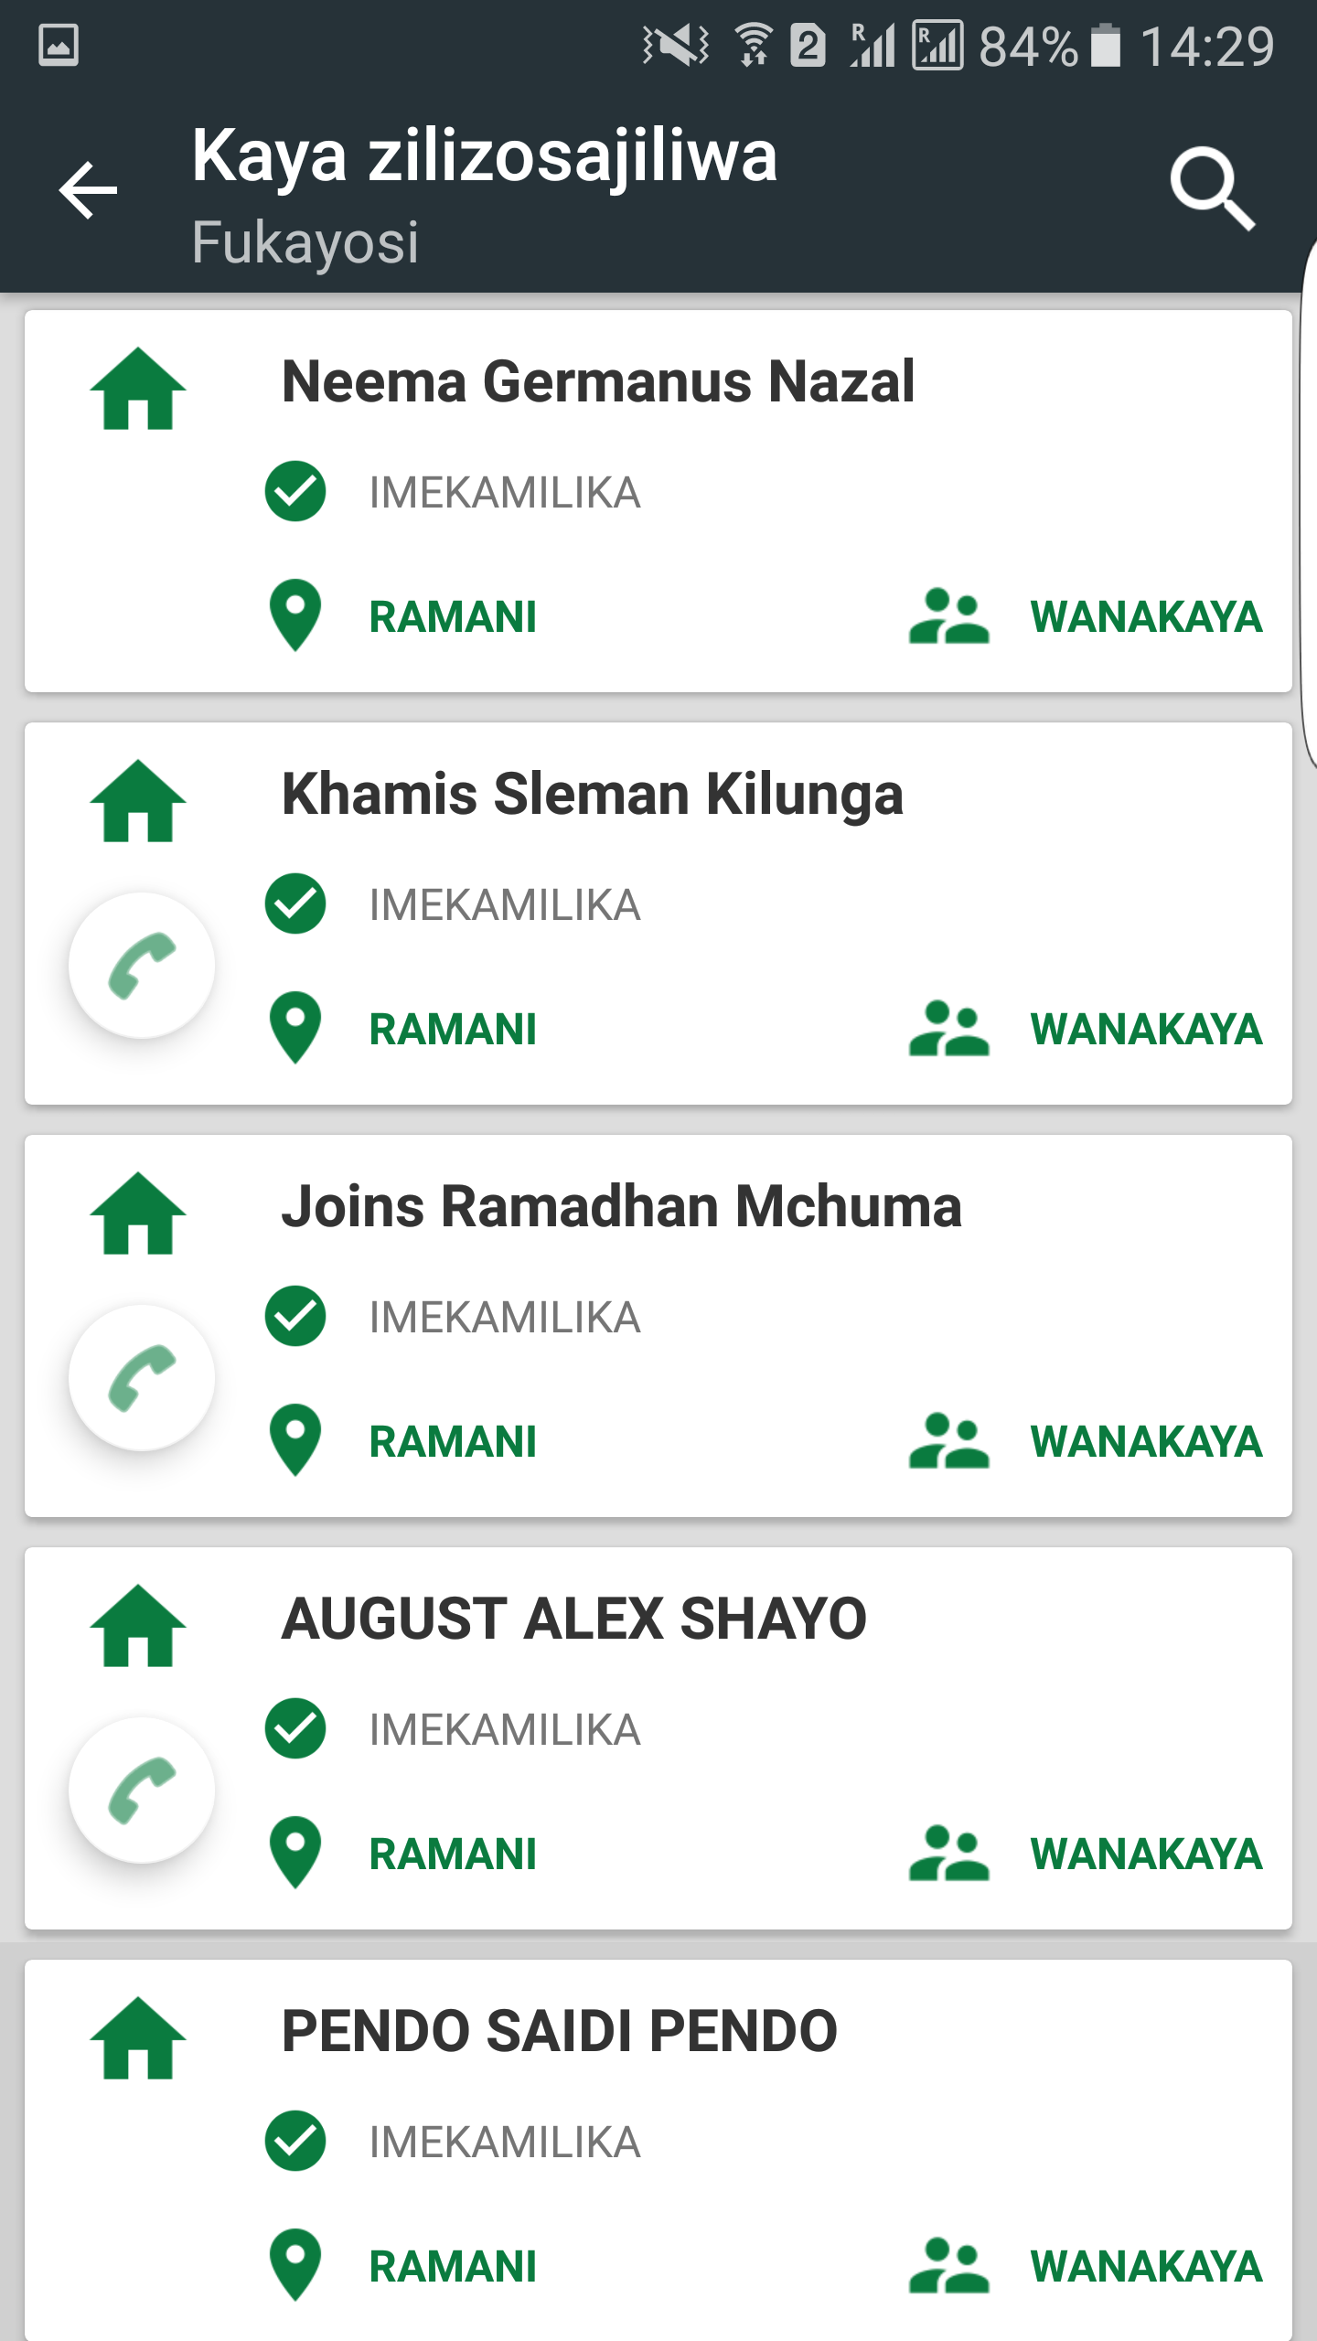
Call an individual/SMS

Slide 13
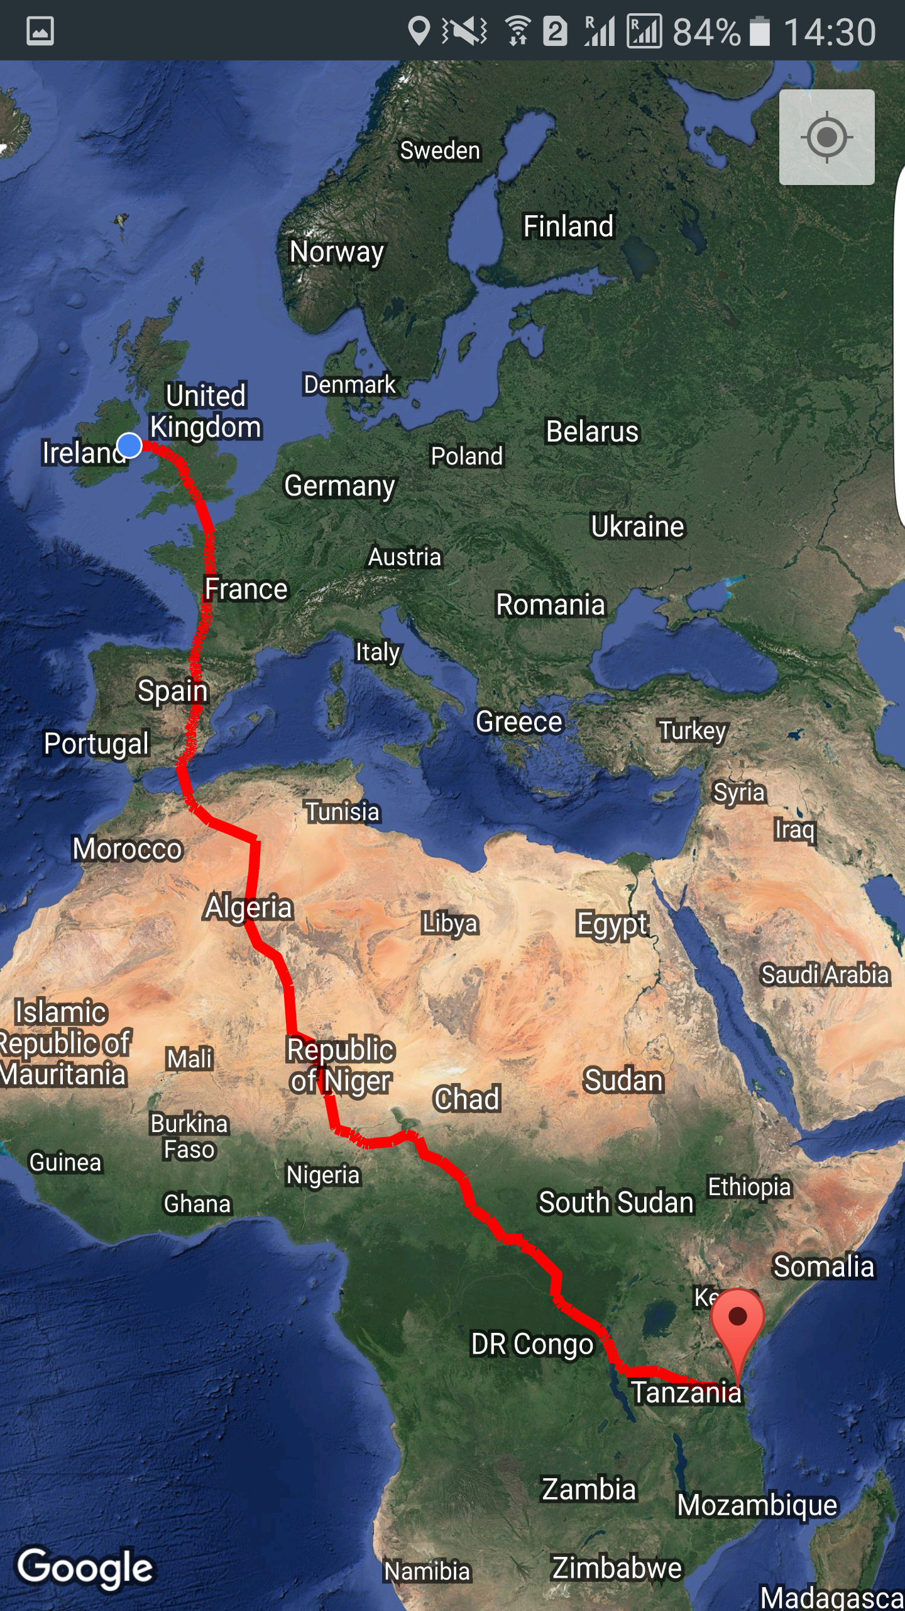
Location of HH

Slide 14

Distance and path to visit the HH

Slide 15
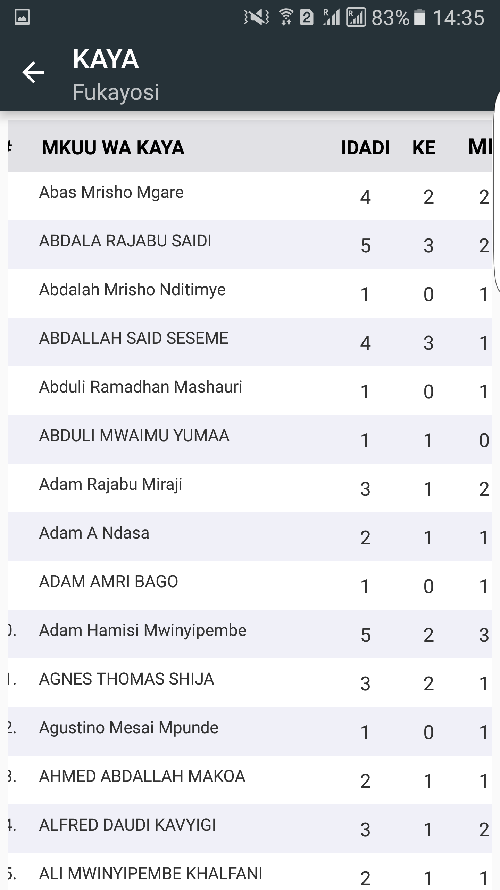
At sub village level

Slide 16
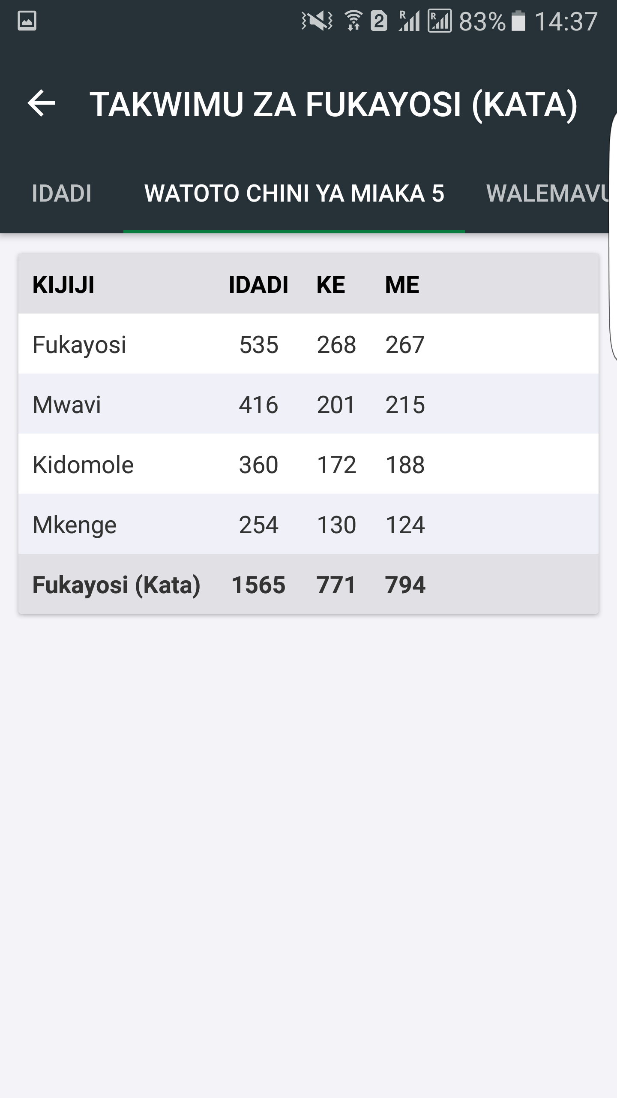
Children Under Five

Slide 17
The Way Forward and Conclusion
Harnessing technologies and partners to build confidence in the use of administrative based data becomes imperative for developing countries where capacities are limited;
Promoting culture of evidence based policy formulation to embrace political will is very essential;
For developing countries 2nd Generation of NSDS should include a component of improving routine data system;

Slide 18
The Way Forward and Conclusion
Custodian International Organization i.e. UN Agencies, IMF and WB to continue working with NSO’s to improve concepts and definitions under administrative data. This go in line with strengthening capacity development of data producers and users in the National statistical System

Slide 19
END – Take Away from this Presentation
“Mobilize All Sources of Data for Leaving no One Behind”.
Thank you for your kind attention

